Slide 1
SOC
SVR
MT
MLP

Slide 2
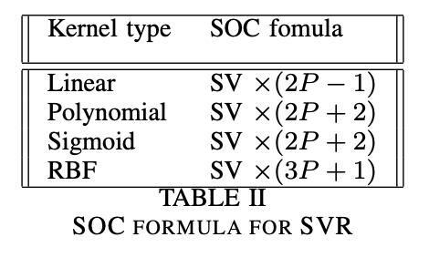
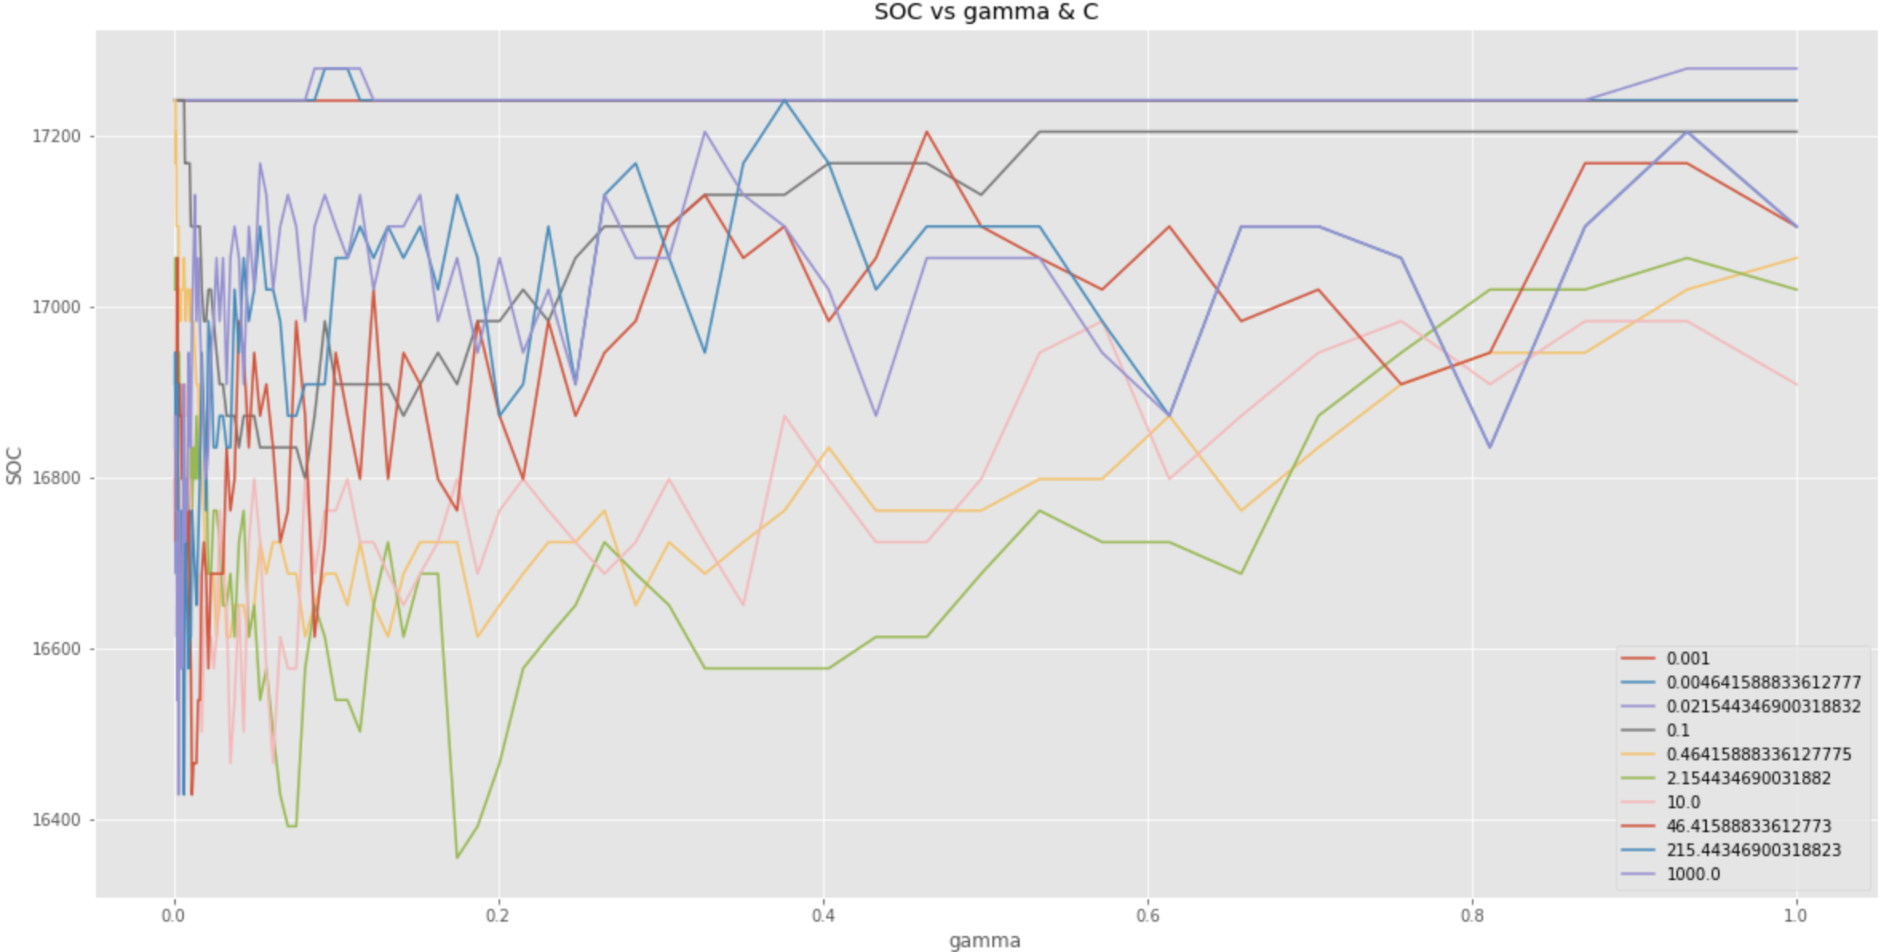
SVR. Method1: Hyper-parameters
Method2: NuSVR to limit number of support vectors
Parameter C: Regularization parameter. The strength of the regularization is inversely proportional to C. Must be strictly positive. The penalty is a squared l2 penalty.[1]
NuSVR: works same as SVR. Only difference is it takes parameter nu - a lower bound of the fraction of support vectors. Should be in the interval (0,1]. By default 0.5 will be taken. [2]
SV-number of support vectors
P-number of features selected
Features are already reduced by VIF, now we try to reduce number of support vectors
SOC values for all possible parameters

Slide 3
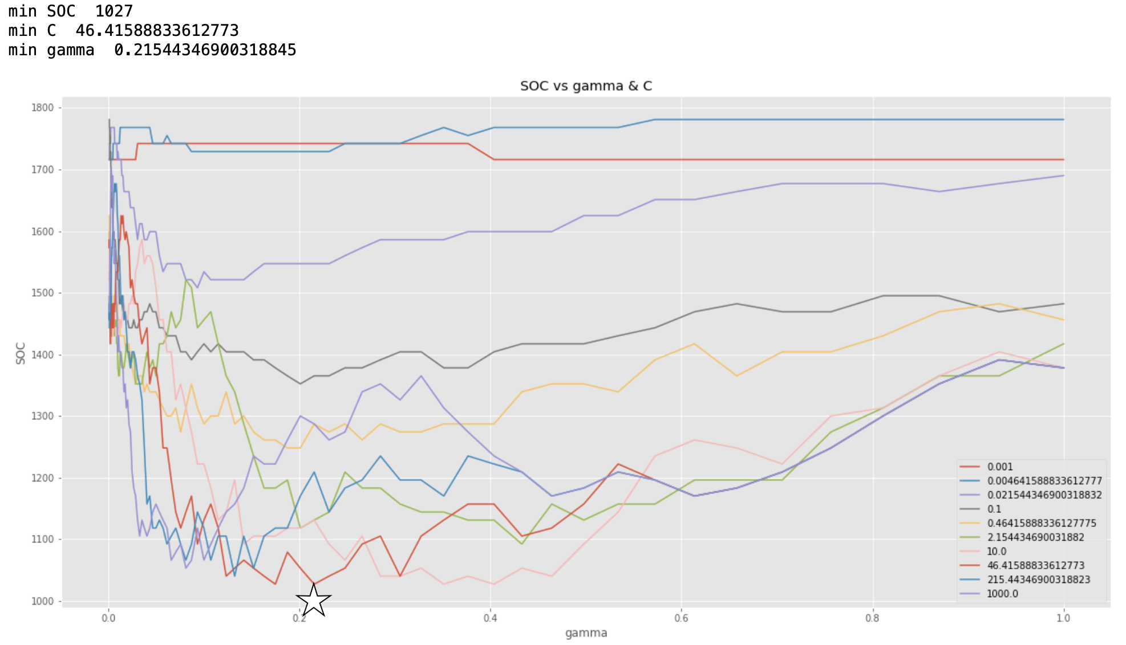
SVR.Servo
Original
Metric\ Dataset | Servo | Auto MPG | Forest Fire
Configuration | SVR(C=46.416,gamma= 0.215, kernel='rbf’) | SVR(C=12.743, gamma= 0.113,'kernel='rbf’) | SVR(C=16.68100537200059,gamma=0.1, 'kernel': 'rbf')
MSE | 0.1312 | 6.375 | 117.763
SOC | 1027 | 5584 | 16761
SV | 79 | 349 | 453
After trying all possible combinations of hyper parameters, the lowest SOC possible is 1027. While our MSE optimized model already has the lowest SOC. Can’t be optimized further with hyper parameters

Slide 4
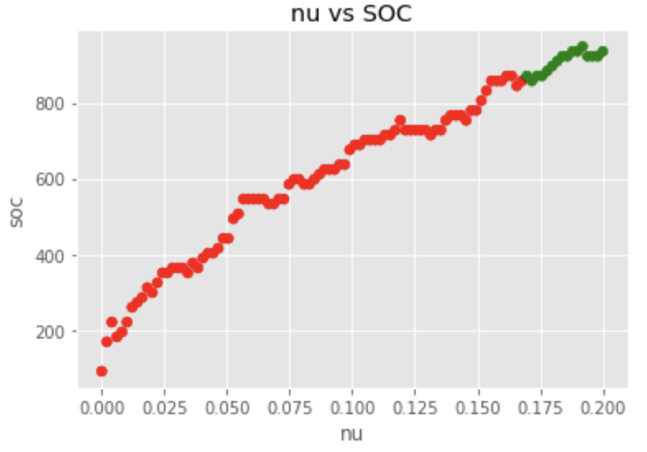
SVR.Servo.NuSVR
Original
Metric\ Dataset | Servo
Configuration | SVR(C=46.416,gamma= 0.215, kernel='rbf’)
MSE | 0.1312
SOC | 1027
SV | 79
Metrics \ Datasets | Servo
Configuration | NuSVR(nu=0.1697,C=46.42, gamma=0.21, kernel='rbf')
MSE | 0.1435 < 0.144 (+9.4 %)
SOC | 871 (-15.19 %)
SV | 67 (-15.19 %)

Slide 5
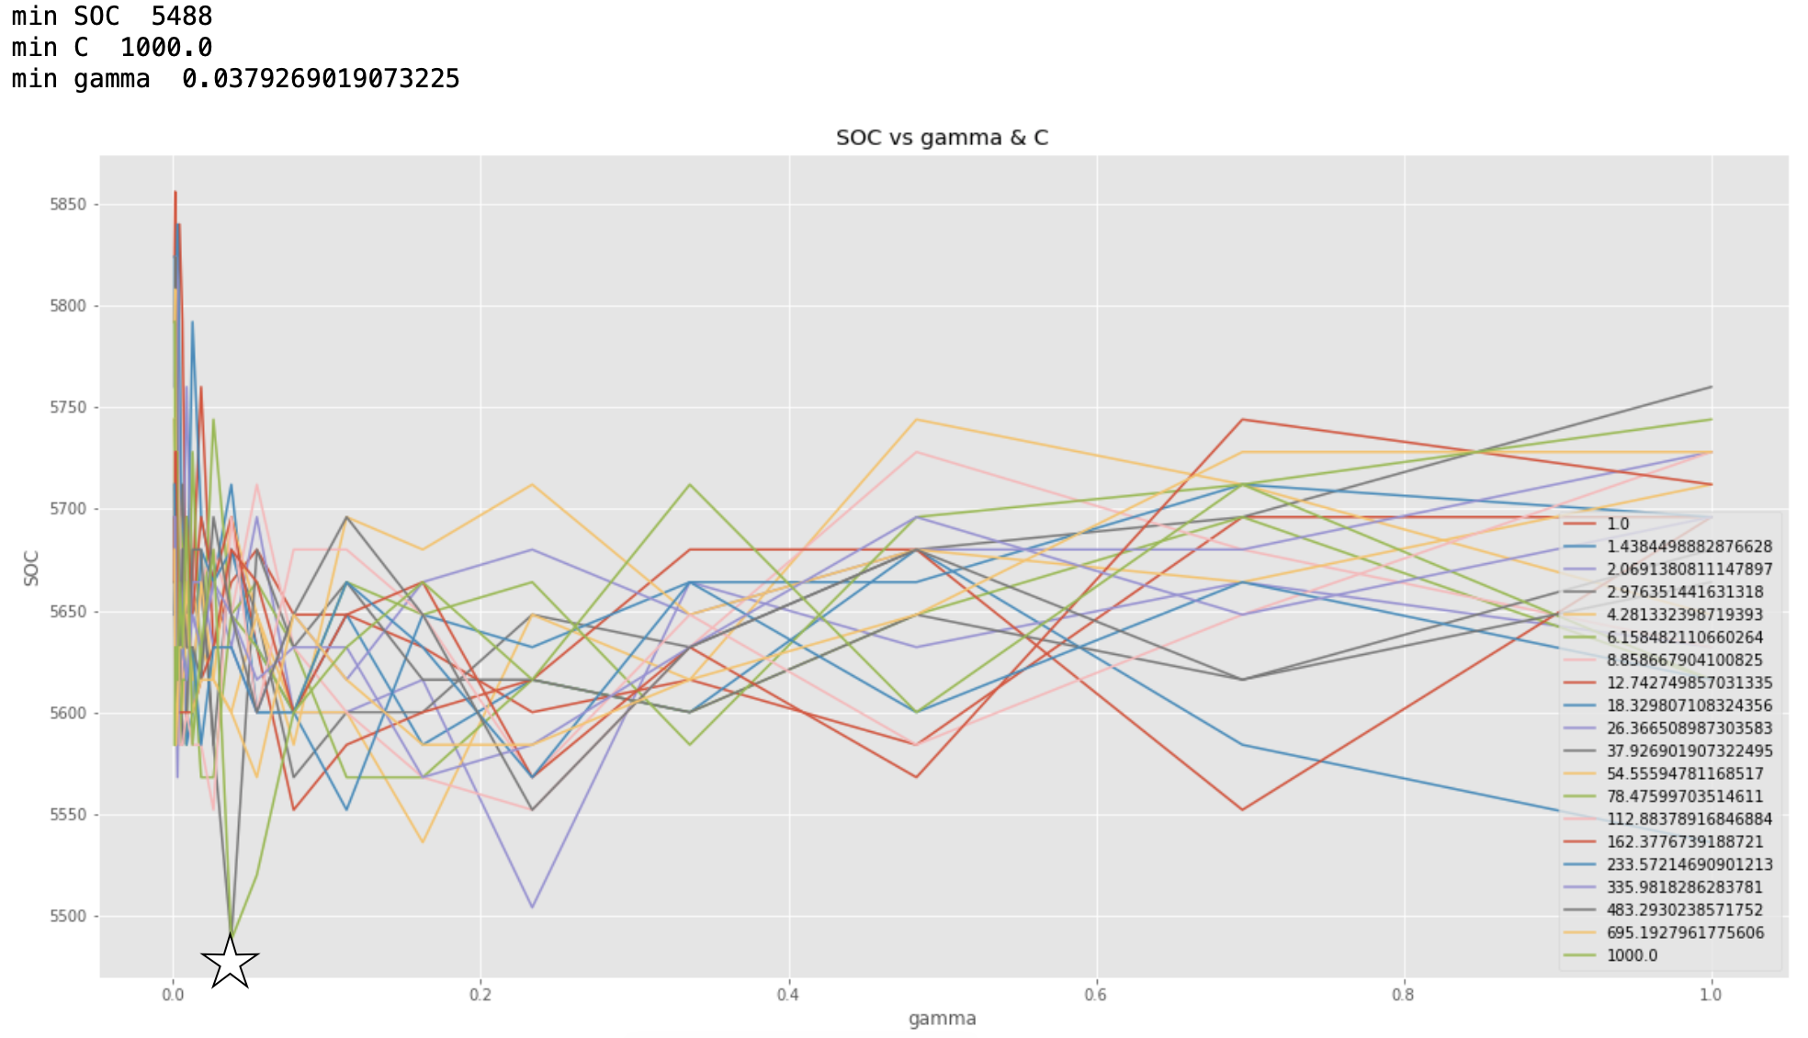
SVR.Auto MPG
Original
Metric\ Dataset | Auto MPG
Configuration | SVR(C=12.742749857031335, gamma= 0.11288378916846883,'kernel='rbf’)
MSE | 6.375
SOC | 5584
SV | 349
After trying all possible combinations of hyper parameters, the lowest SOC possible is 5488. corresponding model gives following results:
Metric\ Dataset | Auto MPG
Configuration | SVR(C=12.742749857031335, gamma= 0.11288378916846883,'kernel='rbf’)
MSE | 6.555 < 7.0 (+2.82 %)
SOC | 5488 (-1.72 %)
SV | 343 (-1.72 %)

Slide 6
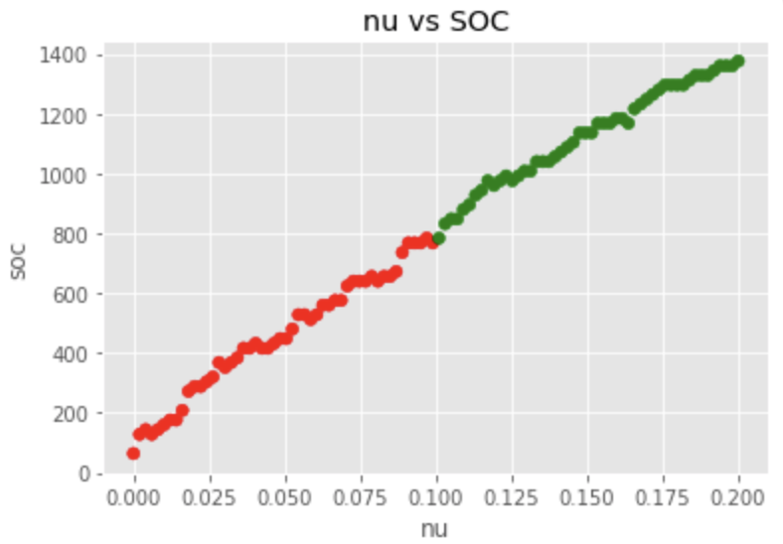
SVR.Auto MPG.NuSVR
Original
Metric\ Dataset | Auto MPG
Configuration | SVR(C=12.742749857031335, gamma= 0.11288378916846883,'kernel='rbf’)
MSE | 6.375
SOC | 5584
SV | 349
The first green point from left to right in x-axis corresponds to nu=0.099, SOC=768
Metric\ Dataset | Auto MPG
Configuration | NuSVR(nu=0.099,C=12.743, gamma = 0.113, kernel='rbf')
MSE | 7.017 (+10.07 %)
SOC | 768 (-86.25 %)
SV | 48 (-86.25 %)

Slide 7
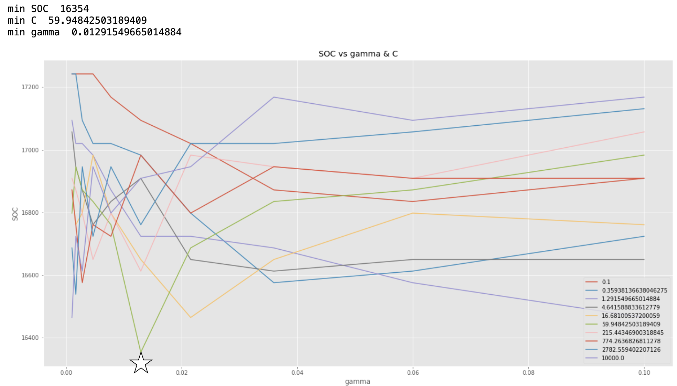
SVR.Forest Fire
Original
Metric\ Dataset | Forest Fire
Configuration | SVR(C=16.68100537200059,gamma=0.1, 'kernel': 'rbf')
MSE | 117.763
SOC | 16761
SV | 453
After trying all possible combinations of hyper parameters, the lowest SOC possible is 16354. corresponding model gives following results:
Metric\ Dataset | Forest Fire
Configuration | SVR(C=59.95,gamma=0.0129, 'kernel': 'rbf')
MSE | 119.84 (+1.76 %)
SOC | 16354 (-2.43 %)
SV | 442 (-2.43 %)

Slide 8
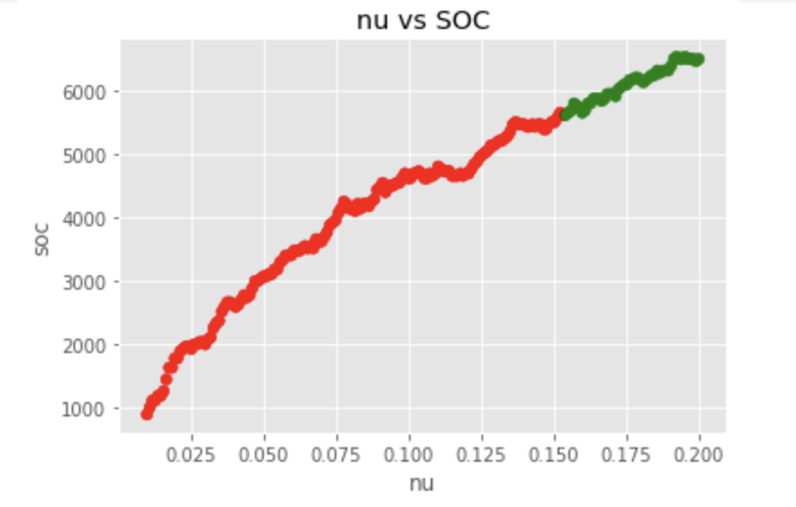
SVR.Forest Fire.NuSVR
Original
Metric\ Dataset | Forest Fire
Configuration | SVR(C=16.68100537200059,gamma=0.1, 'kernel': 'rbf')
MSE | 117.763
SOC | 16761
SV | 453
The first green point from left to right in x-axis corresponds to nu=0.154, SOC=5624
Metric\ Dataset | Forest Fire
Configuration | NuSVR(nu=0.1541708542713568 ,C=16.68,gamma=0.1, 'kernel': 'rbf')
MSE | 129.53 (+9.99 %)
SOC | 5624 (-66.45 %)
SV | 152 (-66.45 %)

Slide 9
SVR. Summary
Increasing interpretability by tuning hyper-parameters is ineffective. For all three datasets maximum reduction in SOC was up to 3% while error rate increased also by up to 3%.
For complex datasets SVR selects “too many” training instances as support vectors. (e.g. in Forest Fire ~96.8%). It can perform poorly on unseen datasets.
NuSVR is another implementation of SVR provided in libsvm can “moderately” reduce number of support vector while keeping error rate “slightly changed”.
For Servo, Auto MPG and Forest fire, number of support vectors reduced by 15, 86 and 66% respectively while error rate increased by around 10%.

Slide 10
MLP.AutoMPG
Find best mse.
First pick default values and best number of layers
Repeat:
Look for params in range +/- C%
Choose next best param.
Stop when mse higher and best param is not changing.
Best layer: (100, 100, 100)
>> (90, 90, 90) < --- best mse
C in [10%, 25%, 50%]. As we get close to true best param, we squeeze the range
Find best soc & mse < limit.
Repeat loop:
Decrease # of neurons 25-50%
Decrease # of layers
Record results.
Stop when mse reach the limit.
Best mse: (90, 90, 90) || 820 soc || 6.794
>> (25, 25) || 100 soc || 7.188

Slide 11
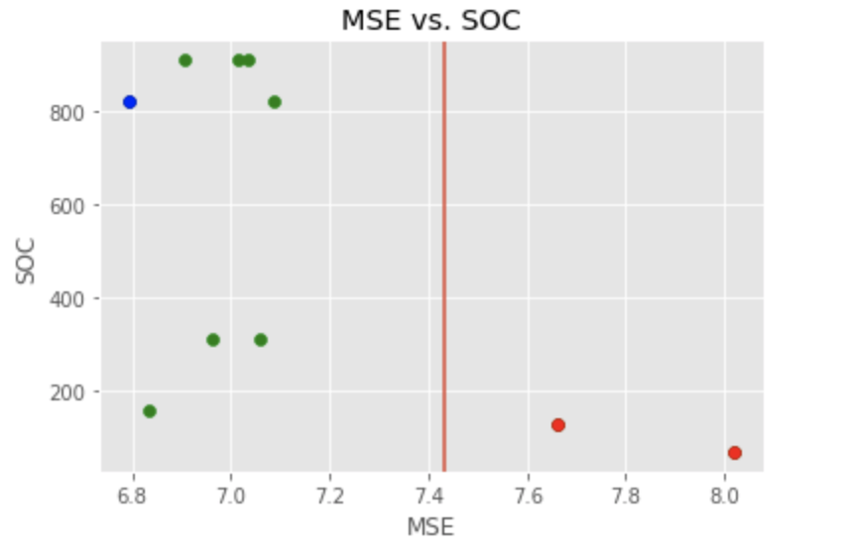
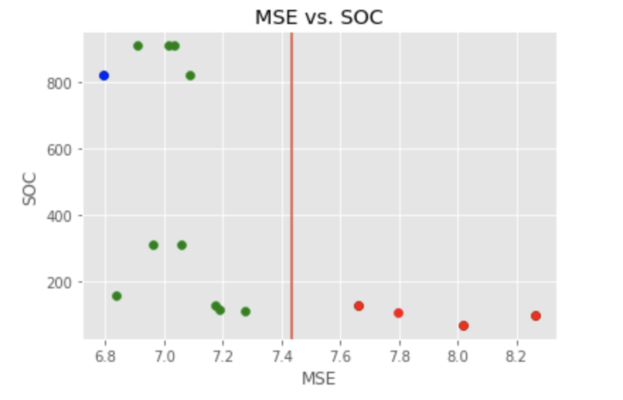
Figure 1. Reaching bound
Figure 2. Finding best param in the range

Slide 12
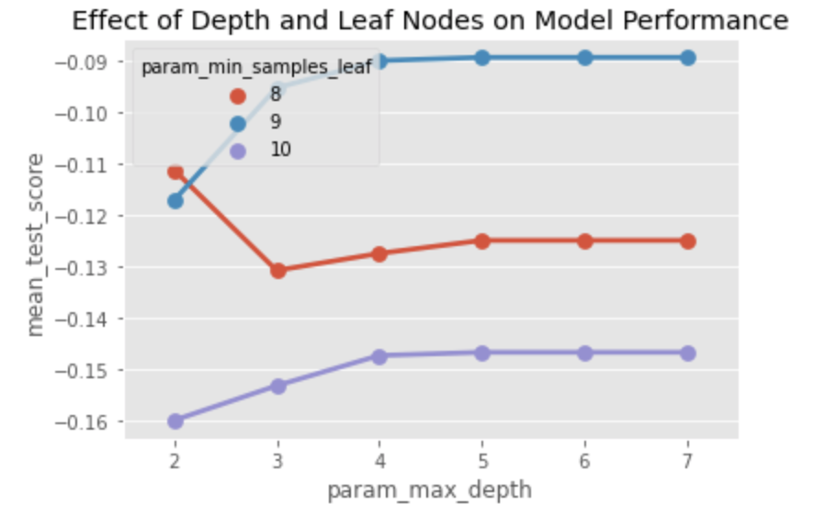
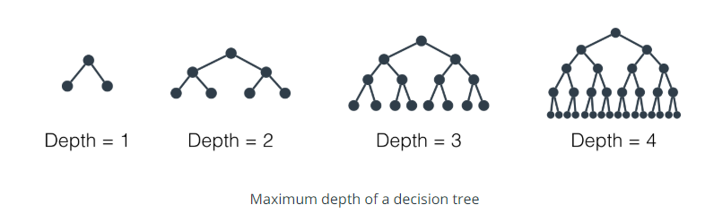
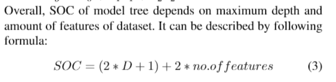
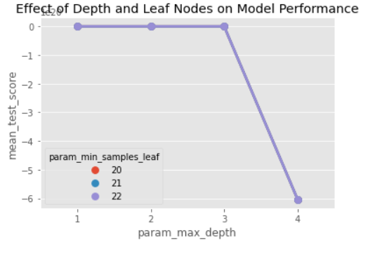
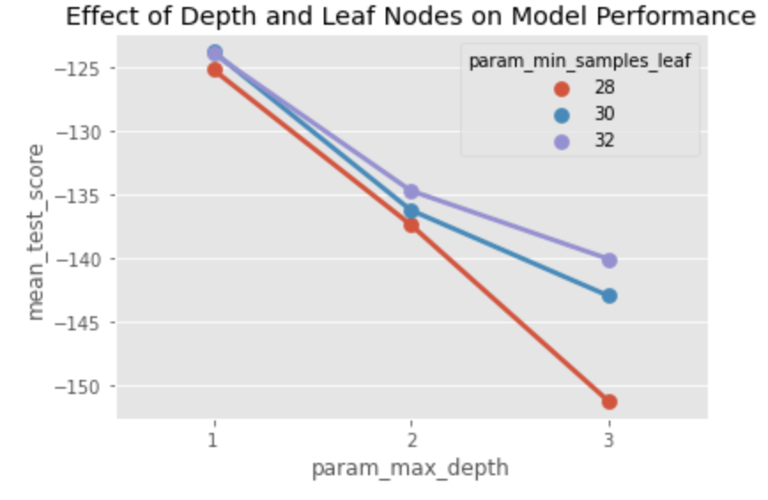
LMT
S
E
R
V
O
We have already done feature selection and now we will try to decrease D-depth to optimize SOC for the model.
FO
R
E
S
T
F
I
R
E
A
U
T
O
M
P
G

Slide 13
LMT. Results
Original
Metric\ Dataset | Servo | Auto MPG | Forest Fire
MSE | 0.0894 | 7.31 | 123.82 108 117
SOC | 19 | 19 | 27
Max Depth | 5 | 3 | 1
SOC optimized
Metrics \ Datasets | Servo | Auto MPG | Forest Fire
Configuration | ‘max_depth’:3, 'min_samples_leaf': 9 | ‘max_depth’:2, 'min_samples_leaf': 22 | ‘max_depth’:1, 'min_samples_leaf': 20
MSE | 0.095(+6.26 %) | 7.359 (+0.67%) | 123.82 (0 %)
SOC | 15 (-21.05 %) | 17 (-10.52%) | 27 (0%)

